Slide 1
DevOps Capstone Project: Enterprise Deployment & Automation
Multi-Environment GitOps CI, SonarQube, Argo CD, DataDog and AI-Ops
Presented by: Jeevan C
Date: June 2026

Slide 2
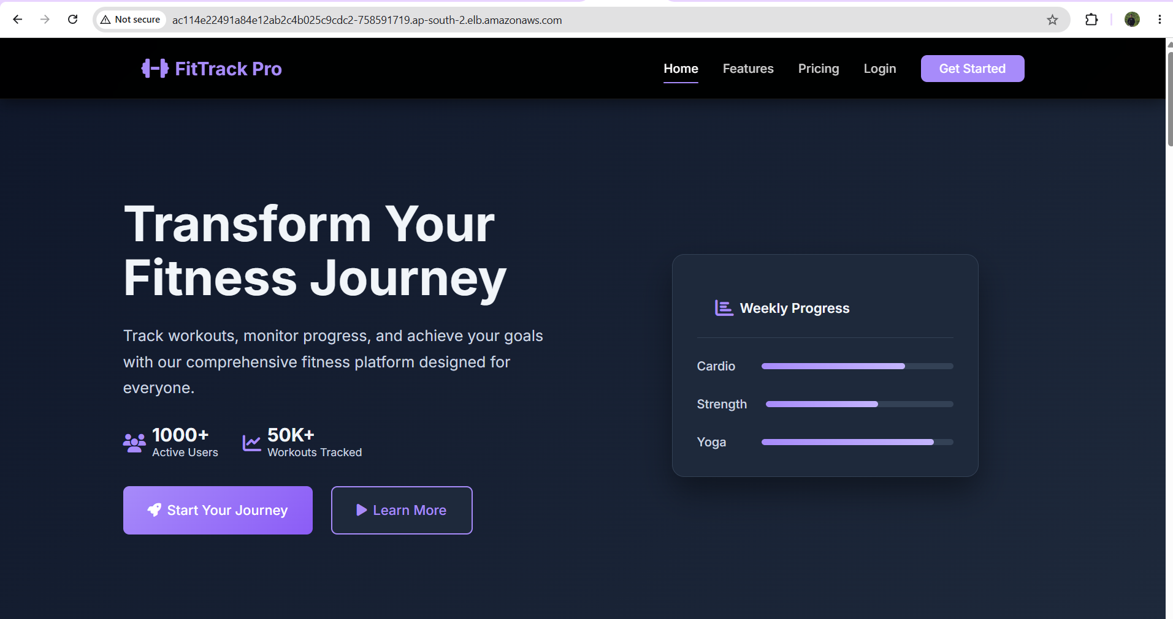
Deployment Architecture & Workflow
• Unified Workflow: Code changes flow from Local Git repo -> GitHub Actions -> AWS ECR -> EKS Cluster namespaces via ArgoCD.
• Environment Isolation: The Kubernetes cluster runs three completely segregated namespaces: Dev, Staging, and Production.
• Gateway API Routing: Client traffic enters through the AWS LoadBalancer and is routed dynamically via the Gateway API.
• Monitoring & Logs: Node-level metrics and container logs are streamed directly to Datadog.

Slide 3
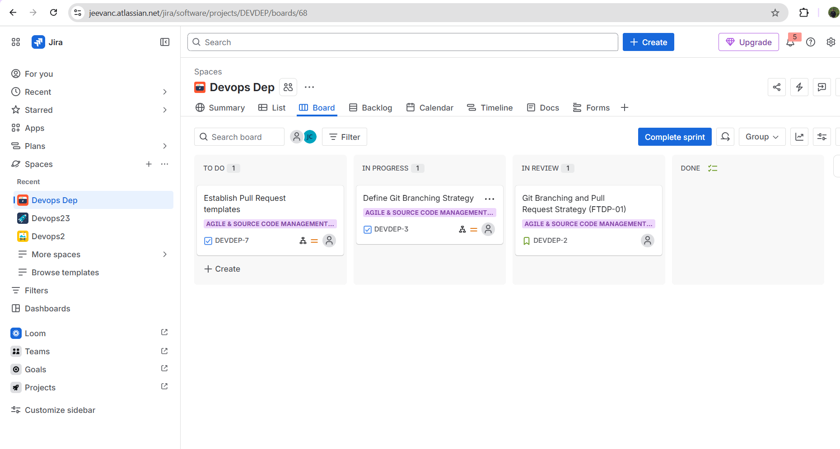
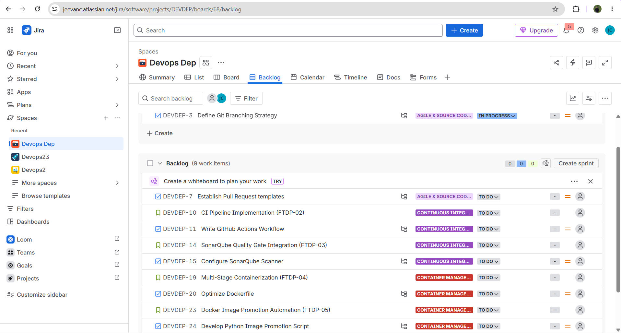
Jira Board & Agile Setup
Configured an Agile Scrum board in Jira with a clear hierarchy of Epics, User Stories, Tasks, and Sub-tasks to manage SCM, CI/CD, GitOps, and Observability phases.

Slide 4
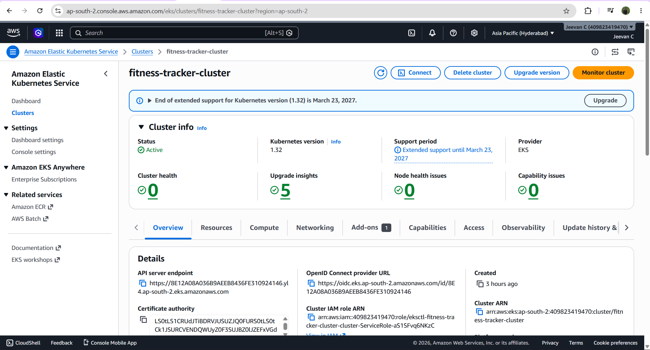
Phase 1 & 2: AWS EKS & Control Server Provisioning
• AWS EKS Cluster: Provisioned an enterprise AWS EKS Cluster ('fitness-tracker-cluster') in ap-south-2 using eksctl with a managed node group.
• Dedicated EC2 Server: Configured a remote Ubuntu management node with Docker, SonarQube Community LTS (port 9000), and a k3s local cluster.
• Network Configuration: Custom Security Groups with opened ingress ports for SonarQube and local ArgoCD Dashboard NodePorts (32542).

Slide 5
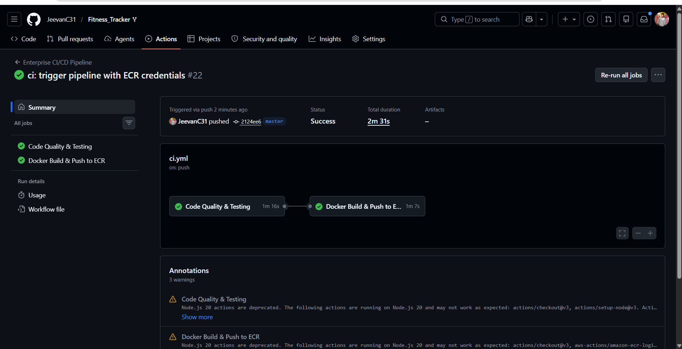
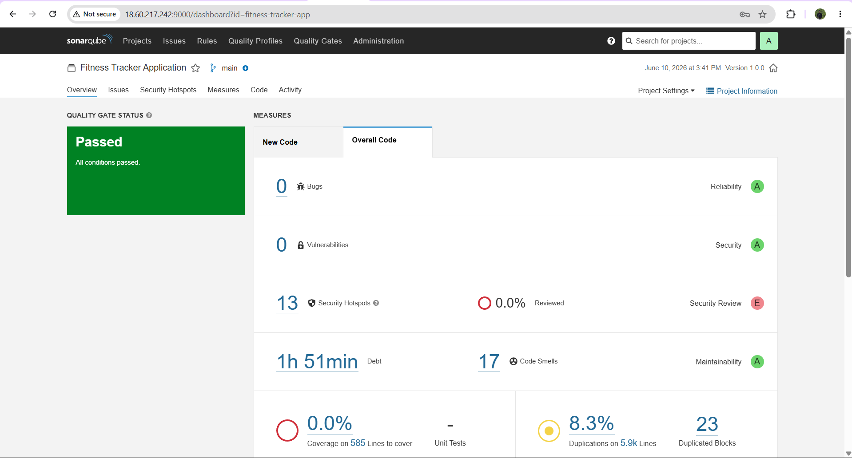
Phase 3: CI/CD Pipeline & Static Code Analysis
• GitHub Actions Pipeline: Configured automated validation workflow triggered on every push or pull request to develop, staging, and master branches.
• Linting & Unit Tests: Validates syntax styling via ESLint and runs frontend/backend unit tests before compiling container images.
• SonarQube Scan Integration: Invokes SonarQube Scanner using secrets and rejects workflow execution if the custom Quality Gate criteria is not met.

Slide 6
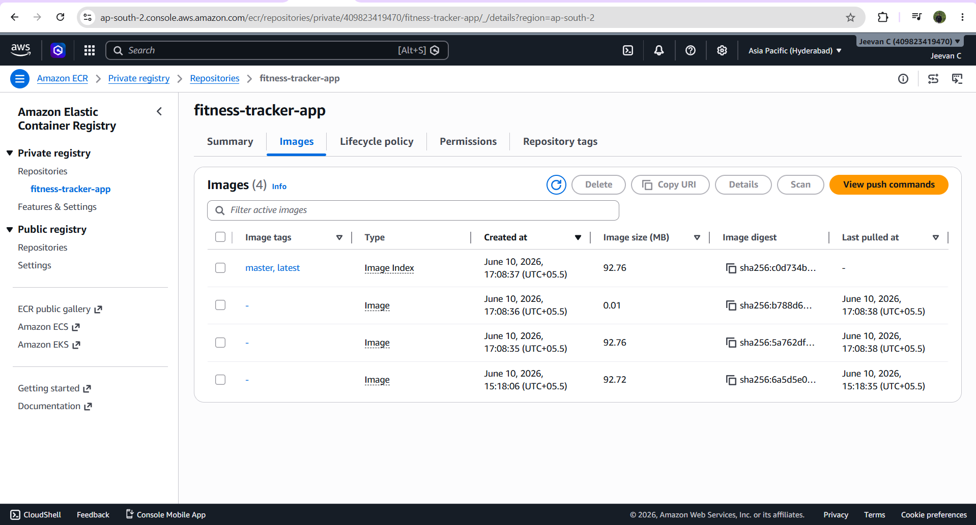
Phase 3.5: AWS ECR Registry & Automated Promotion
• Private AWS ECR Registry: Secure AWS ECR repository initialized in the EKS region to store and pull application images.
• Image Promotion Principle: Automated the image promotion script in the CI pipeline to copy tested images between environments (develop -> staging -> master) without rebuilding.
• Consistency and Reliability: Ensures the exact same verified binary deployed in dev is promoted all the way to production, eliminating compile-time drift.

Slide 7
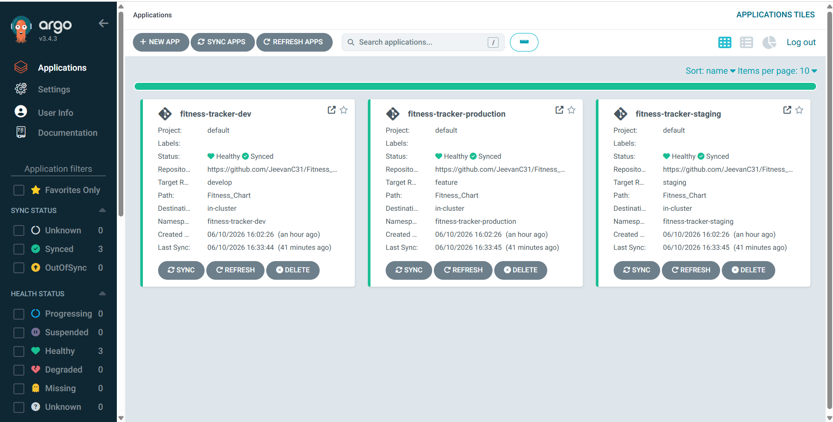
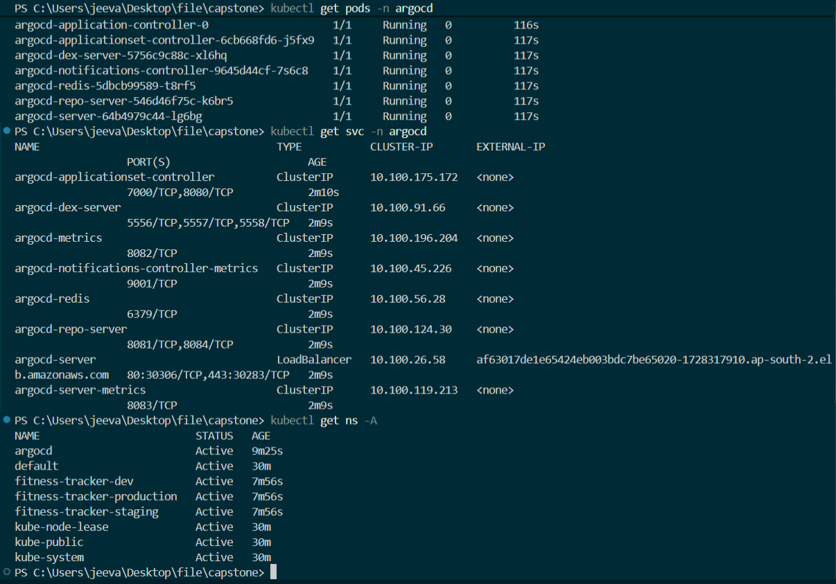
Phase 4: GitOps Continuous Delivery with ArgoCD
• GitOps Agent on EKS: ArgoCD deployed inside the EKS cluster namespace. Serves as the single source of truth for the cluster states.
• Git Repository Synchronization: Watches changes in the Git repository's Helm chart files and automatically pulls and updates Kubernetes workloads.
• Target Revision Tracking: App configured to sync develop branch to Dev environment, staging branch to Staging, and master branch to Production namespace.

Slide 8
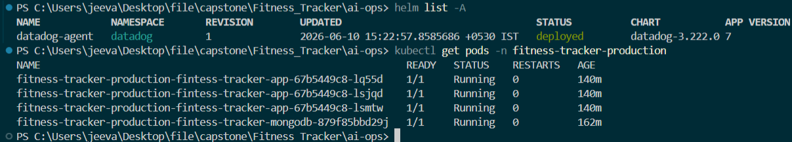
Active Kubernetes Workloads & Pods
• Multi-Namespace Isolation: Deployed apps in fitness-tracker-dev, fitness-tracker-staging, and fitness-tracker-production namespaces.
• App Pods & Replicas: Scaling set up per environment (1 replica in dev, 2 replicas in staging, and 3 replicas in production).
• Database Setup: MongoDB Stateful deployment configured in each namespace with persistent volume (PV) directories mapped to local storage mount paths.

Slide 9
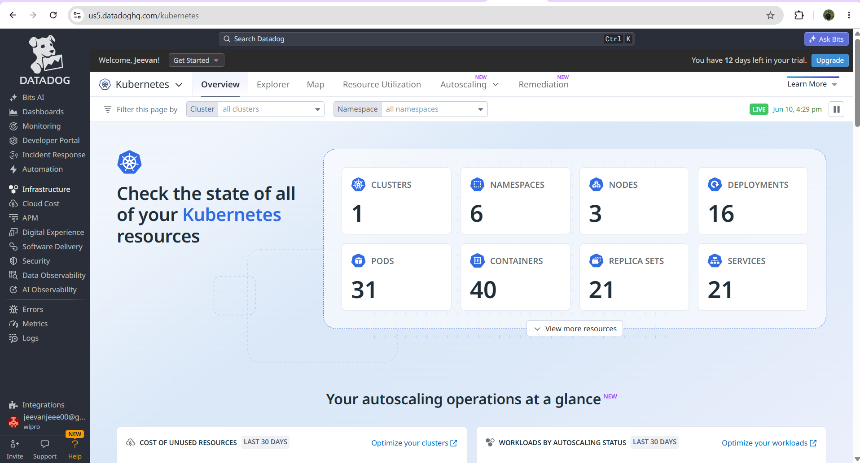
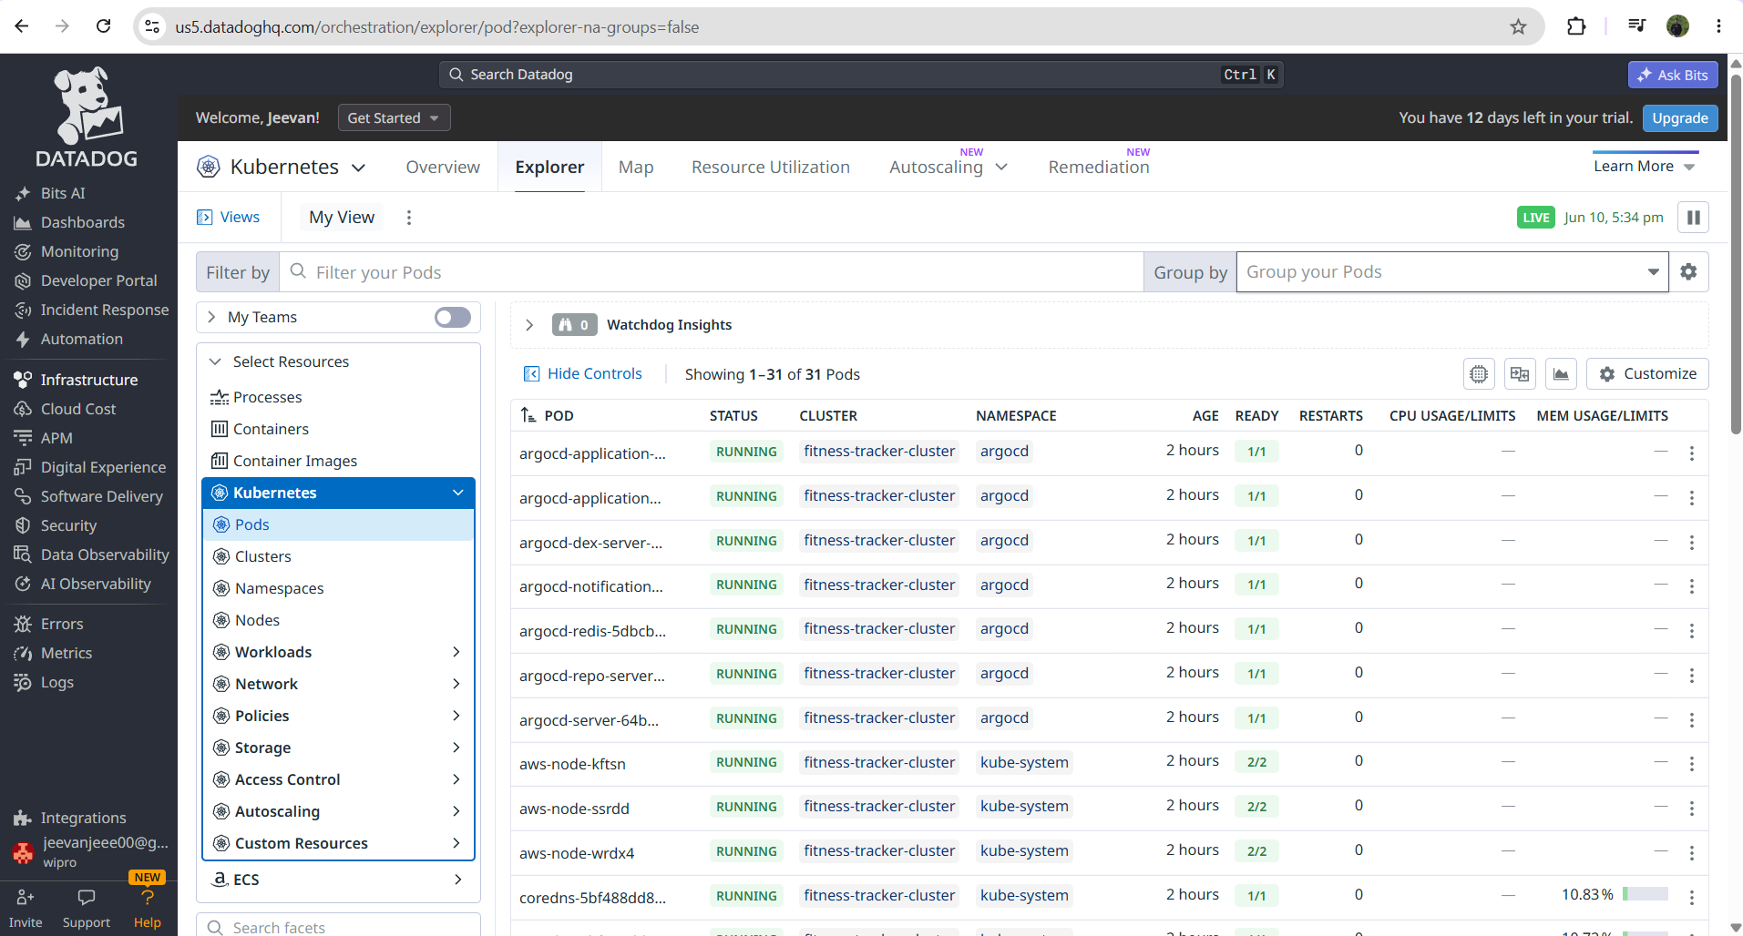
Phase 5 & 11: Enterprise Observability with Datadog
• Datadog DaemonSet: Deployed Datadog agent daemonset globally to the cluster using Helm to inspect every running node.
• Log & Metrics Harvesting: Configured logs enablement and container auto-collection. Streams app logs, JVM/Node.js memory metrics, and host CPU loads.
• APM Tracing Integration: Node.js environment variables (DD_ENV, DD_SERVICE, DD_VERSION) map pod traces directly to Datadog's APM server.

Slide 10
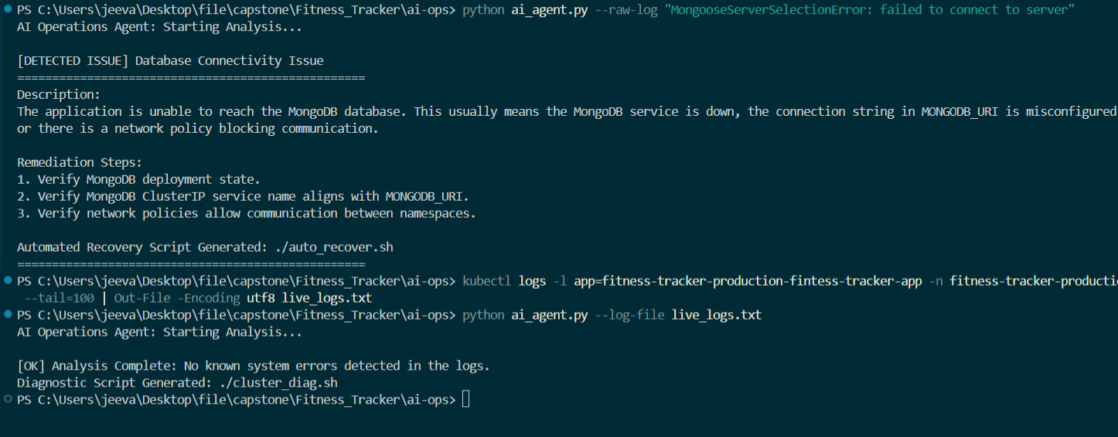
Phase 8 & 12: AI-Ops SRE Agent & Self-Healing
• Automated Log Scanner: Implemented an automated python SRE agent that pulls and reads live application container stdout logs.
• Intelligent Failure Detection: Identifies specific crashes such as database connection issues (Mongoose errors), OOM container exits, or secret key omissions.
• Auto-Recovery Generation: Automatically outputs diagnosis execution scripts (`cluster_diag.sh` or `auto_recover.sh`) to self-heal the workloads instantly.

Slide 11
Verification, Rollback & Infrastructure Teardown
• Deploy Verification: Inspected pod status via `kubectl get pods` across all namespaces to guarantee 1/1 Running status and validated exposed service IPs.
• 1-Click Rollback: ArgoCD maintains detailed history revisions. In case of failure, a rollback can be executed instantly to revert the environment to a previous stable commit tag in Git.
• Clean Resource Teardown: Executed complete resource destruction using `eksctl delete cluster` and AWS CLI ECR force-delete commands to clean up the nodes, volumes, load balancers, and container registry fully, preventing billing leaks.

